Slide 1
SFA PRINTS PVT LTD: WEB DEVELOPMENT
SUMMER INTERNSHIP PROJECT (SEM V)
KAVISH S
2022115001
Btech IT, 3rd Year

Slide 2
INTRODUCTION
During my internship at SFA Print Private Limited, I had the opportunity to contribute to the development of a new feature for one of their key clients, Matrikas, a well-known brand specializing in premium stationery products. The project involved adding a new tab labeled "2025' DIARIES" to the Matrikas website’s homepage. This tab showcases a range of latest themed diaries, each offering unique designs and features tailored for the upcoming year.

Slide 3
Problem Definition
The website needed an update to include a comprehensive 2025 Diaries section and a functional chatbot to improve user engagement and support. The 2025 Diaries tab had to be developed from scratch, incorporating a dropdown menu with various themes like Impresso, Metallic, and Antique, each displaying product specifications and an image gallery for easier browsing. Additionally, the site required a chatbot integration to handle user queries more efficiently, providing an interactive and automated solution through Collect.chat to enhance customer support. These improvements were essential to optimize the website’s usability and overall user experience.

Slide 4
Objective
The objective of this project was to enhance the website by developing a new 2025 Diaries section, improving the Contact Us page UI, and integrating an interactive chatbot to enhance user engagement and support. The 2025 Diaries tab was designed to provide a seamless browsing experience, featuring categorized themes with detailed product specifications and visual galleries. Additionally, the chatbot integration aimed to streamline customer interactions by offering an efficient query resolution system, while the Contact Us page was refined to improve usability. Overall, the goal was to optimize the website's functionality, accessibility, and overall user experience.

Slide 5
System Architecture
1. Frontend Layer (Presentation Layer)
HTML/CSS/JavaScript Frameworks: The frontend layer was built using standard web technologies like HTML, CSS, and JavaScript to ensure a responsive and user-friendly interface across all devices.
2025 Diaries Tab: A dedicated section within the frontend was developed with a dropdown menu that allows users to select different themes like Impresso, Metallic, and Antique. Upon selection, product details such as dimensions, material quality, and an image gallery are displayed dynamically.
Contact Us UI: The contact form was redesigned with cleaner fields for subscriber details (name, email, phone number, country, and message box) and integrated with Google reCAPTCHA for added security and spam prevention.
Chatbot (Collect.chat Integration): The chatbot interface was seamlessly integrated into the frontend to provide users with an intuitive way to resolve queries. It uses conversational UI elements to guide users in real time.

Slide 6
2. Backend Layer (Application Layer)
Server-Side Framework (e.g., Node.js, PHP): The backend manages the logic for fetching diary product details, handling form submissions from the Contact Us page, and processing chatbot queries. Depending on the existing website setup, either a Node.js or PHP server could be used to handle routing and serve the frontend components.
Product Database Management: A backend API is used to retrieve diary theme specifications from the database based on user selections. Queries sent to this API return product data such as size, material, and gallery images for the selected theme.
Chatbot Logic (Collect.chat): The chatbot service, powered by Collect.chat, interacts with backend services to handle user inquiries. It is pre-configured to respond to common questions and provide accurate information by integrating with existing data sources.

Slide 7
3. Data Layer (Database Layer)
Product Database: A database (such as MySQL, MongoDB, or Firebase) stores the details of each diary theme, including size, material, price, and associated product images. This database is queried when users interact with the 2025 Diaries section.
Form Data Storage: Data submitted via the Contact Us page is stored in a secure backend database, where it can be accessed for customer follow-up and support.

Slide 8
4. Third-Party Integrations
Collect.chat: The chatbot feature is managed through the Collect.chat service, which provides a conversational interface for customer support. It can be configured to answer FAQs, guide users through website features, or escalate issues to human representatives if needed.
Google reCAPTCHA: Integrated into the Contact Us form to ensure security and prevent spam submissions.

Slide 9
5. Deployment Architecture
Web Hosting: The website is hosted on a scalable web hosting service (e.g., AWS, Azure, or shared hosting) capable of handling fluctuating traffic demands, especially for features like product galleries and the chatbot.
Version Control & CI/CD: Code changes for the website are managed via version control systems (e.g., Git), and continuous integration/continuous deployment (CI/CD) pipelines automate deployment, ensuring smooth updates to the live site.

Slide 10
Design
1. User Interaction with the 2025 Diaries Tab
Step 1: Diary Theme Selection
Trigger: The user visits the 2025 Diaries section and selects a theme (e.g., Impresso, Metallic, Antique) from the dropdown menu.
Frontend: When the user makes a selection, JavaScript captures the event and sends an AJAX request to the backend server for fetching the corresponding product details.
Step 2: Backend Request Handling
Backend: The backend (Node.js, PHP, or similar) receives the request, validates the selected theme, and queries the database for the relevant details of the chosen theme.
Database: The database (MySQL, MongoDB, etc.) contains tables/collections with fields for each diary theme, including dimensions, materials, prices, and image URLs.

Slide 11
Step 3: Response and Display
Backend Response: The server retrieves the product data and sends a JSON response back to the frontend.
Frontend Rendering: JavaScript processes the response and dynamically updates the page, displaying the diary specifications and gallery images associated with the chosen theme. CSS is used to ensure responsive rendering and optimal display on all devices.
Step 4: Gallery Interaction
Frontend Gallery: The image gallery allows users to browse through the available diary designs. A JavaScript-based gallery viewer (e.g., a lightbox plugin) is used to display the images in an interactive format, allowing zooming, scrolling, and full-screen viewing.

Slide 12
2. Chatbot Interaction (Collect.chat Integration)
Step 1: User Opens Chatbot
Trigger: The user clicks on the chatbot icon, located in the corner of the website. The chatbot interface pops up, allowing users to enter queries or start a conversation.
Frontend: The chatbot interface is embedded into the website using Collect.chat's widget code, which is loaded asynchronously to avoid performance delays on the main page.
Step 2: User Query Submission
User Input: The user types a query (e.g., "What are the diary dimensions?").
Collect.chat Service: The chatbot processes the query using its pre-configured workflow. The chatbot can respond using predefined scripts or, if integrated with a knowledge base, it can fetch the relevant answer.

Slide 13
Step 3: Response to User
Chatbot Logic: Based on the user's query, Collect.chat either provides a direct answer or prompts the user to choose from a list of options for more detailed queries.
Frontend Response: The chatbot displays the response or follows up with additional prompts for further clarification, guiding the user to a resolution.
Step 4: Escalation (If Required)
Escalation to Human Agent: If the user’s query cannot be answered by the chatbot, it can be escalated by sending an email notification or offering the user a form to fill out for a customer support callback. This is configurable within Collect.chat’s workflow settings.

Slide 14
3. Contact Us Page Interaction
Step 1: Form Submission
Trigger: The user fills out the Contact Us form, providing details like name, email, phone number, country, and a message, and completes the Google reCAPTCHA challenge.
Frontend Validation: JavaScript performs basic client-side validation to ensure that all required fields are filled out and that the email/phone number formats are correct.
Step 2: reCAPTCHA Verification
Security Step: The Google reCAPTCHA service verifies the user’s action to ensure they are not a bot. If the reCAPTCHA verification passes, the form submission proceeds.

Slide 15
Step 3: Form Data Submission
AJAX Request: The form data is submitted to the backend using an AJAX call, ensuring a seamless user experience without a full page reload.
Backend Validation: The backend server performs further validation on the form data (checking for SQL injection or invalid entries) before processing.
Step 4: Data Storage and Response
Database Insertion: If the data is valid, it is inserted into the backend database for future reference.
Response to User: Upon successful submission, the frontend displays a confirmation message thanking the user for their inquiry. The user is also sent a confirmation email, acknowledging their submission.

Slide 16
Tech Stack
Frontend Technologies:
HTML
CSS
JavaScript (with frameworks like jQuery)
Backend Technologies:
Node.js or PHP (for server-side logic)
Database:
MySQL or MongoDB (for data storage)

Slide 17
Chatbot Integration:
Collect.chat (for chatbot functionality)
Form Validation and Security:
Google reCAPTCHA (for form submission security)
Version Control:
Git (for code management)

Slide 18
Chatbot Integration:
Collect.chat (for chatbot functionality)
Form Validation and Security:
Google reCAPTCHA (for form submission security)
Version Control:
Git (for code management)

Slide 19
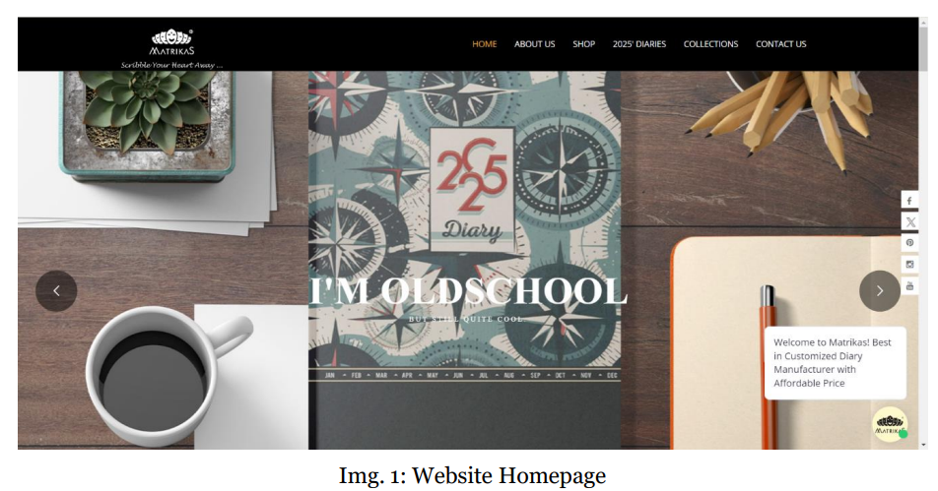
Project Images

Slide 20
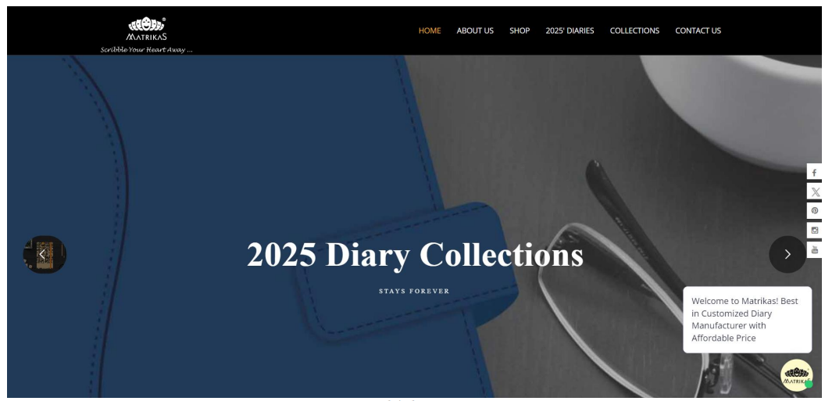

Slide 21
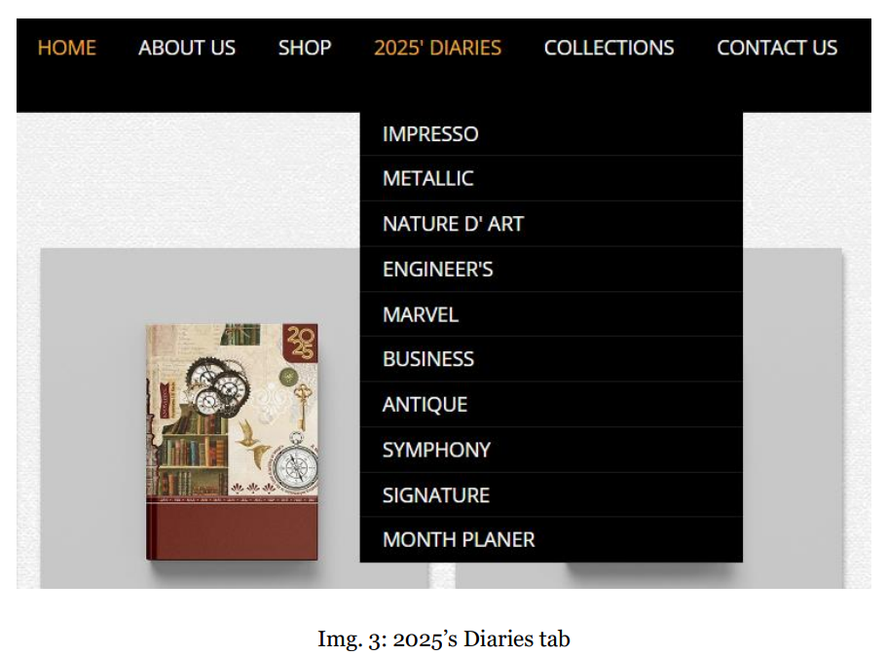

Slide 22
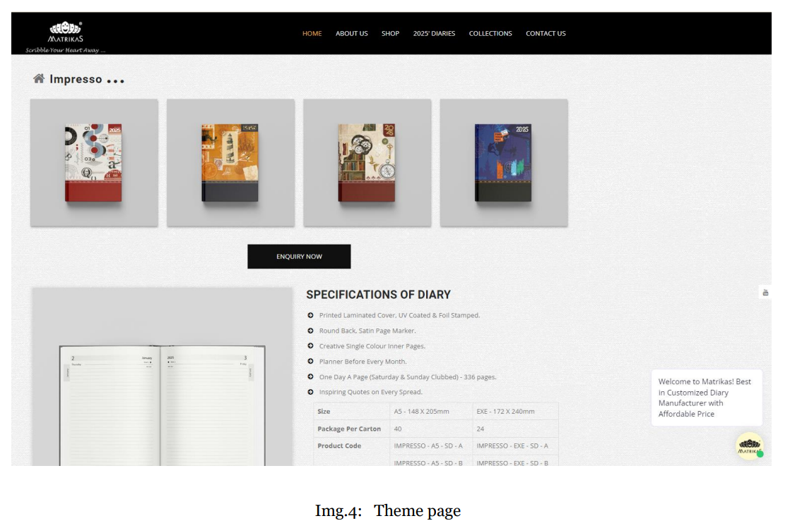

Slide 23
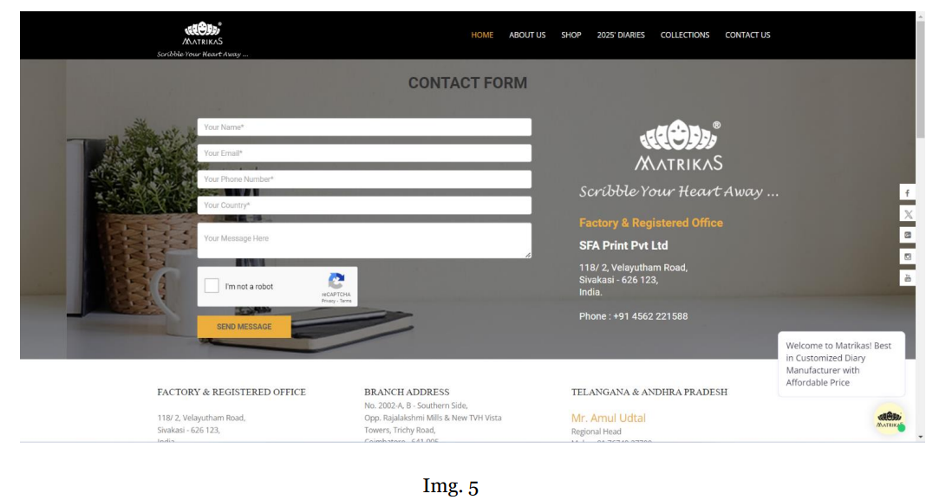

Slide 24
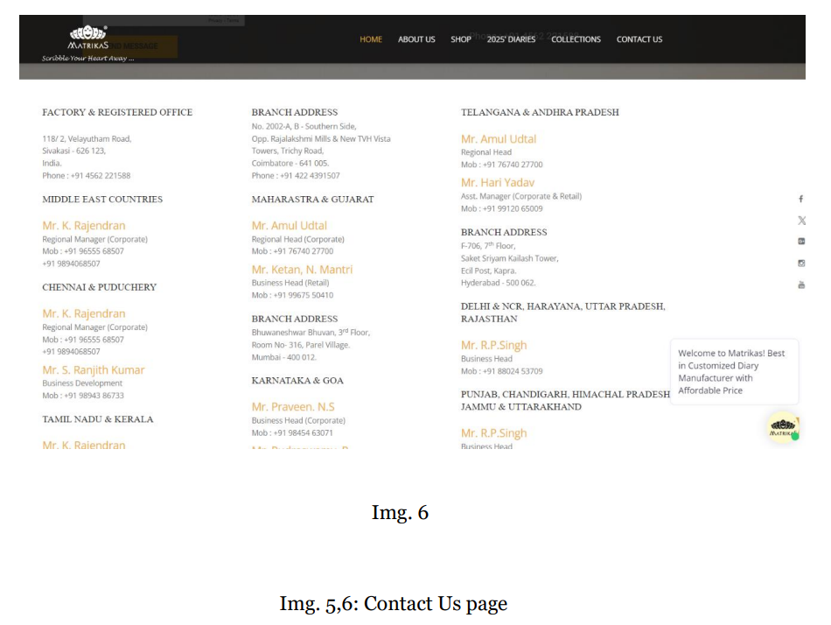

Slide 25
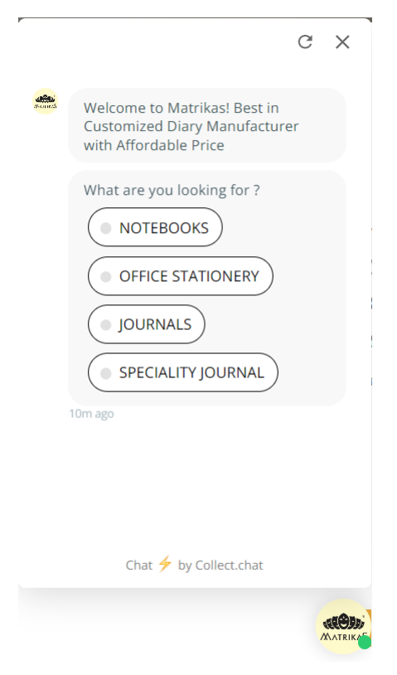
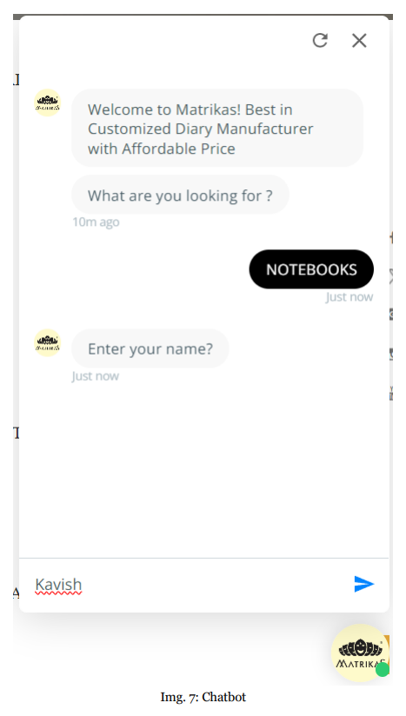

Slide 26
Results
The final result of the project was a significantly enhanced website featuring a dedicated 2025 Diaries section that allows users to explore various diary themes with detailed specifications and visual galleries. Additionally, the integration of a user-friendly chatbot streamlined customer interactions by providing real-time query resolution. The Contact Us page was revamped to improve usability and security, including a form with Google reCAPTCHA. Overall, these enhancements optimized the website's functionality, improved user engagement, and provided a more intuitive experience for visitors.

Slide 27
Reference
[i] https://collect.chat/
[ii] https://api.jquery.com/
[iii] https://www.w3schools.com/bootstrap/
[iv] https://www.netguru.com/glossary/node-js
[v] https://developers.google.com/recaptcha/intro

